Slide 1


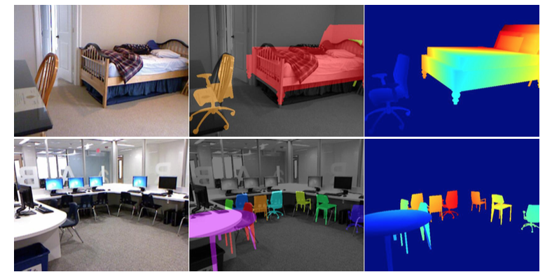
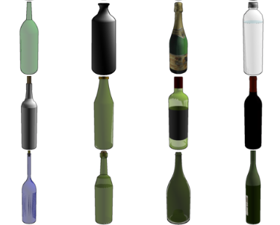
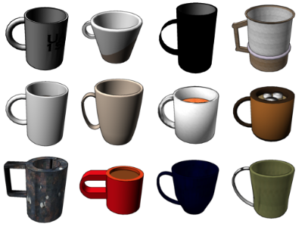
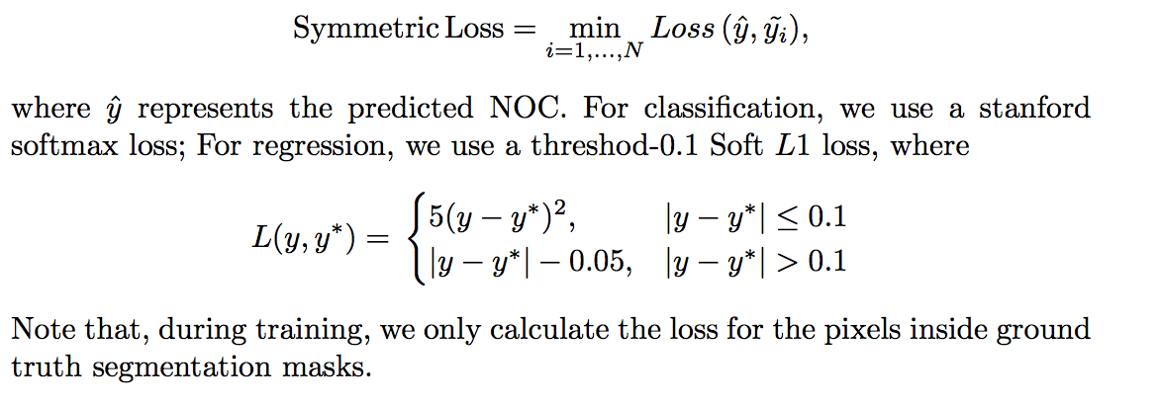
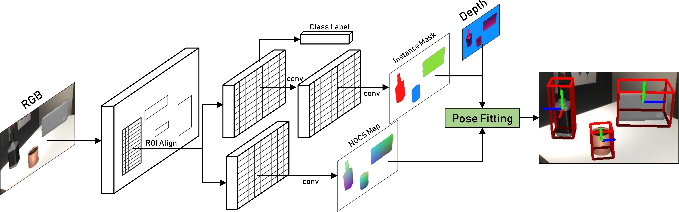
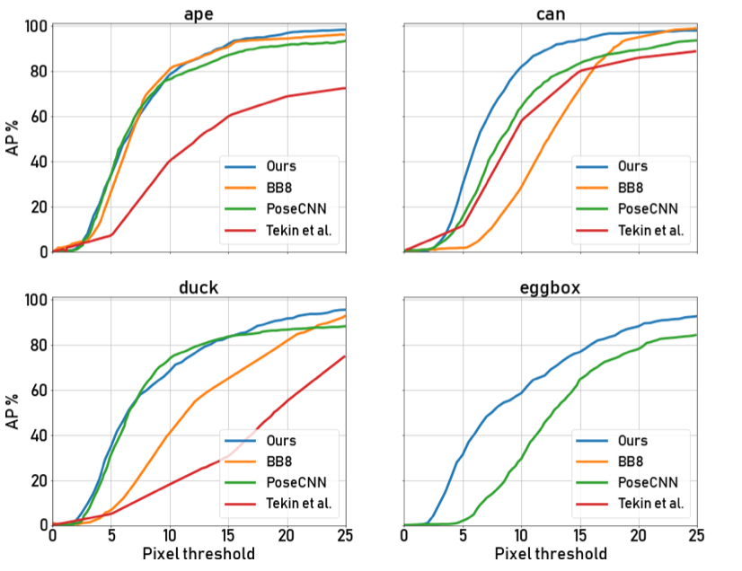
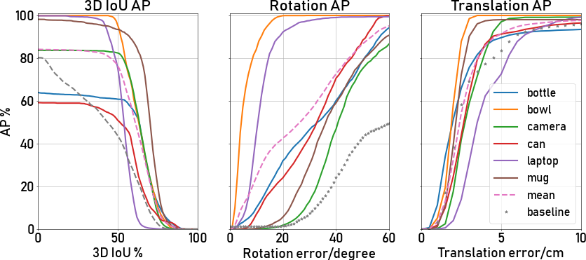
CSCI 1430
Your Clever 1430 Project Title
Person One Person Two Person Three Person Four
Motivation
Define the problem
Goal
Use figures!
Make sure any text is concise, precise, and large.
Exemplar Fitting [2] Model retrieval + alignment. Not necessary for defining category-level pose.
Canonical 6D Pose
Emerges from intra-class similarity.
Can be consistently defined for each category.
State Goals
Do X. Blah blah blah.
Do Y. Blah blah blah.
What is the insight into the problem that leads to the solution?
More details. Explain how it works.
Provide concise and precise information at low density.
Results (images/figures)
More results
References
Acknowledgements
[1] Xiang, Yu et al. “PoseCNN: A Convolutional Neural Network for 6D Object Pose Estimation in Cluttered Scenes.” CoRR abs/1711.00199 (2018): n. pag.
[2] S. Gupta, P. Arbela ́ez, R. Girshick, and J. Malik. Aligning 3d models to RGB-D images of cluttered scenes. In Proc. Of CVPR 2015.
[3] A. X. Chang, T. Funkhouser, L. Guibas, P. Hanrahan, Q. Huang, Z. Li, S. Savarese, M. Savva, S. Song, H. Su, et al. Shapenet: An information-rich 3d model repository. arXiv:1512.03012, 2015.
We would like to thank…

